Slide 1
Go Clean
CMPT 2400 & CMPT 3510
Presented by:-
Dionathan Santos
Harshdeep Kaur
Navkirat Singh
Rajveer Singh
Vinit Kataria
November 5, 2024
Instructor Names – Maryam Mirzaei and Mohammad Ajallooeian
Notes:
Nav
Hello everyone, thank you for joining us today. We are excited to present our project, titled 'Go Clean.' This is part of our coursework for CMPT 2400 and CMPT 3510.
My name is Navkirat Singh, and I am here with my teammates Dionathan Santos, Harshdeep Kaur, Rajveer Singh, and Vinit Kataria. Together, we have been working on analyzing data from the National Pollutant Release Inventory (NPRI) and creating a model to draw meaningful insights from it.
We’d like to acknowledge and thank our instructors, Maryam Mirzaei and Mohammad Ajallooeian, for their guidance and support throughout this project.
Let’s get started!

Slide 2

Understanding the data
To understand the dataset, we performed the analyses using the following methods:
shape()
head()
describe()
info()
value_counts()
Notes:
Nav
Before anything else, Let's take a moment to dive into our dataset and understand its structure in detail.
First, we used the shape function. The dataset has 7 hundred thousand rows and 28 columns, indicating it's a massive collection with extensive records and features. Such a large dataset often requires efficient data management techniques to ensure optimal processing.
Moving on, the head function allowed us to preview the first few rows. Here, we observed some key columns, like Reporting Year, NPRI ID, Number of Employees, Province, and various release types.
Notably, we see a lot of entries with Null values in the releases column. Observing this at an early stage helps set expectations for later analysis and highlights critical steps which we needed to implement in study.
Then we used describe for statistical summany. Interestingly, the mean latitude and longitude values show that most facilities are located within typical Canadian geographic ranges, though there are some extreme coordinates, like a minimum latitude of 0 and a minimum longitude of -140.8, which may represent errors or outliers.
In summary, our initial data exploration has unveiled valuable insights into the dataset’s structure and content. We’ve noted areas with missing data, potential outliers, and have identified key columns for in-depth analysis. Armed with this understanding, we’re now ready to move forward with more focused analytical approaches.

Slide 3
Issue Detection
Data had 84% missing data in the spills releases column.
Mixed English and French column names made working with features challenging.
Repeatedly uploading the CSV was troublesome, so we mounted Google Drive for easy access.
Many unwanted features were present, requiring extensive feature selection to keep relevant columns only for the ML part.
There were some substance names which have notations with their name
Notes:
Dionathan

Slide 4
Pattern Discovery
The oil and gas industry often has the most spills in terms of both number and amount, especially in places like Alberta and Saskatchewan. This matches the high levels of oil production in these areas.
The data also shows a slow rise in the total number of spills over the years, with some sudden increases.
Notes:
Vinit

Slide 5
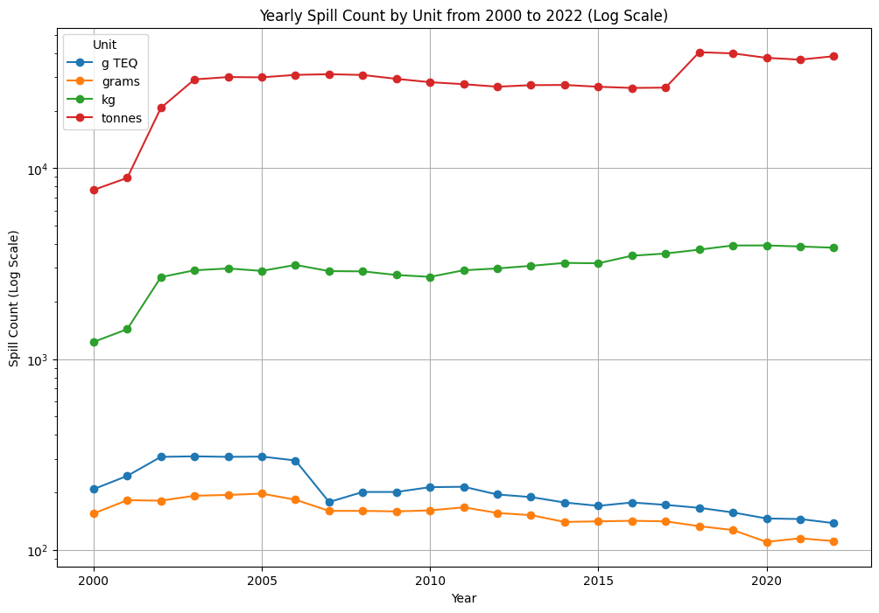
Yearly Spill Count by Unit from 2000 to 2022
While spills of substances measured in large volumes (tonnes) have increased, it does not necessarily mean that more harmful or heavy pollutants are on the rise.
The decrease in G-TEQ spills suggests improved management of highly toxic substances, which is a positive outcome for reducing environmental risk.
Notes:
Harshdeep

Slide 6
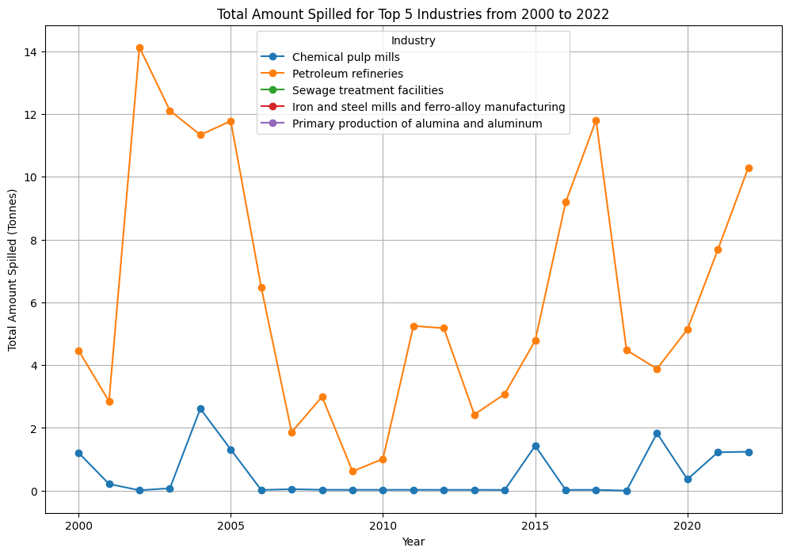
Total Amount Spilled for Top 5 Industries from 2000 to 2022
Petroleum refineries show a stable yet persistent spill volume over time, likely due to aging infrastructure and increased production demands.
This sustained spill rate suggests that outdated systems under higher processing loads contribute significantly to spill risks in the industry.
Notes:
Nav
Here's a detailed look at your chart titled "Total Amount Spilled for Top 5 Industries from 2000 to 2022." It highlights the volume of spills (in tonnes) over the years for five different industries,
represented by distinct colored lines:
One important trend is the fluctuating increase and decareases in spill volume in petroleum refineries, shown by the orange line.
This spill rate is mainly due to two reasons:
Old Equipment: Many refineries use old systems that are more likely to fail and leak.
Higher Production: When production goes up, refineries operate at higher capacities, which increases the risk of spills.
These points show the need to update infrastructure and improve maintenance to reduce spill risks.

Slide 7
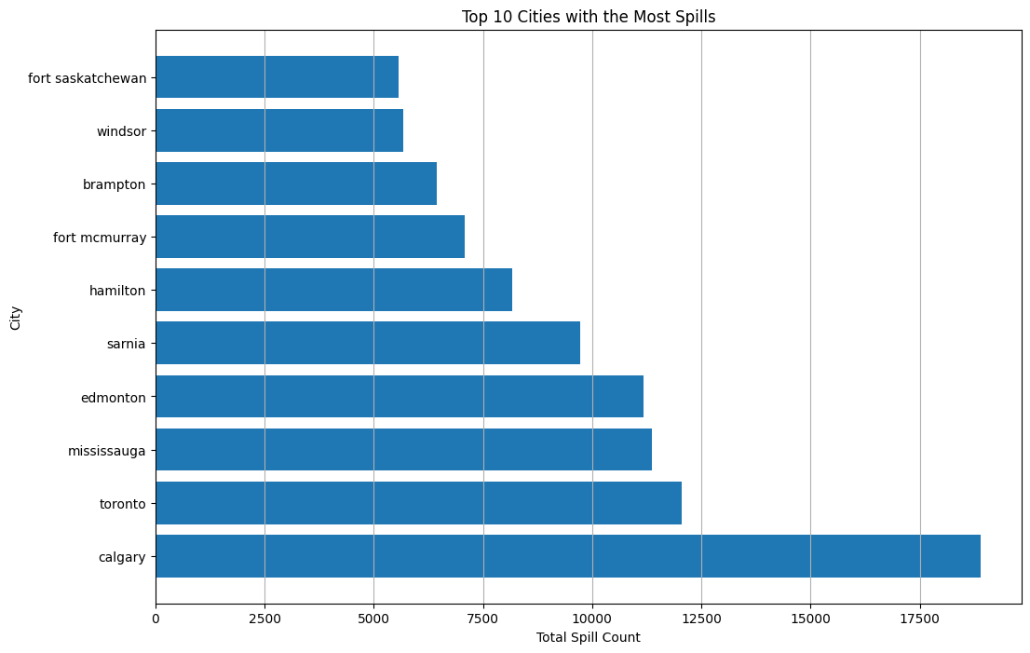
Top 10 Cities with the Most Spills
Calgary has the highest total spill count, significantly surpassing other cities, with nearly twice the spill incidents of Toronto, the next highest city.
This pattern may indicate a need for enhanced spill management and preventative measures in Calgary, reflecting its critical role in the oil and gas sector.
Notes:
Dionathan Calgary’s top spot highlights the impact of its oil and gas industry, where spills are more common. This data points to an urgent need for better spill prevention in Calgary to address its unique environmental challenges. Clearly, targeted management here could make a significant difference!

Slide 8
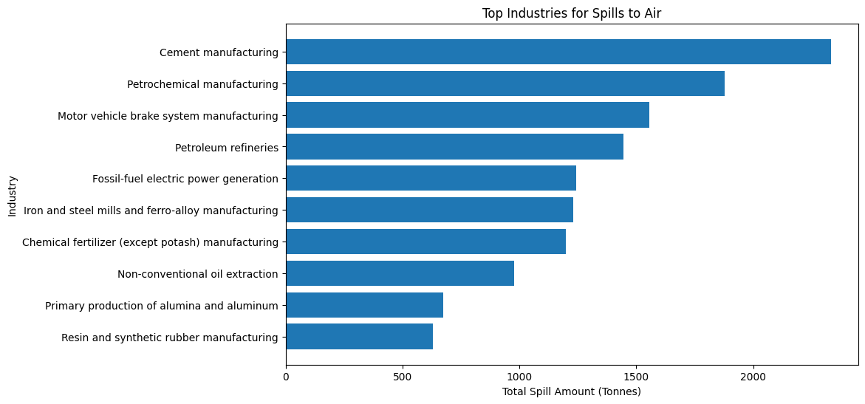
Top Industries for Spills to Air
while cement manufacturing is essential to Canada’s economy and infrastructure, its environmental impact and regulatory costs present challenges. Balancing economic benefits with environmental responsibility is key for the industry's sustainable future in Canada.
Notes:
Vinit

Slide 9
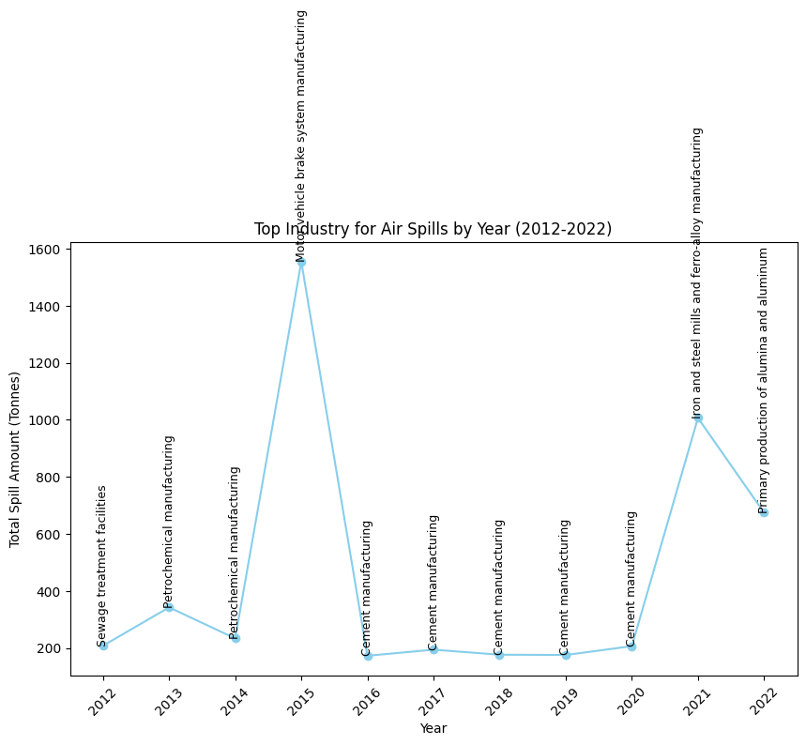
Top Industry for Air Spills by Year (2012-2022)
The 2015 spike in air spills in motor vehicle brake manufacturing likely resulted from adjustments to comply with new Canadian Motor Vehicle Safety Regulations, which impacted air and hydraulic brake systems, causing operational disruptions and increased material usage.
Notes:
Harshdeep

Slide 10
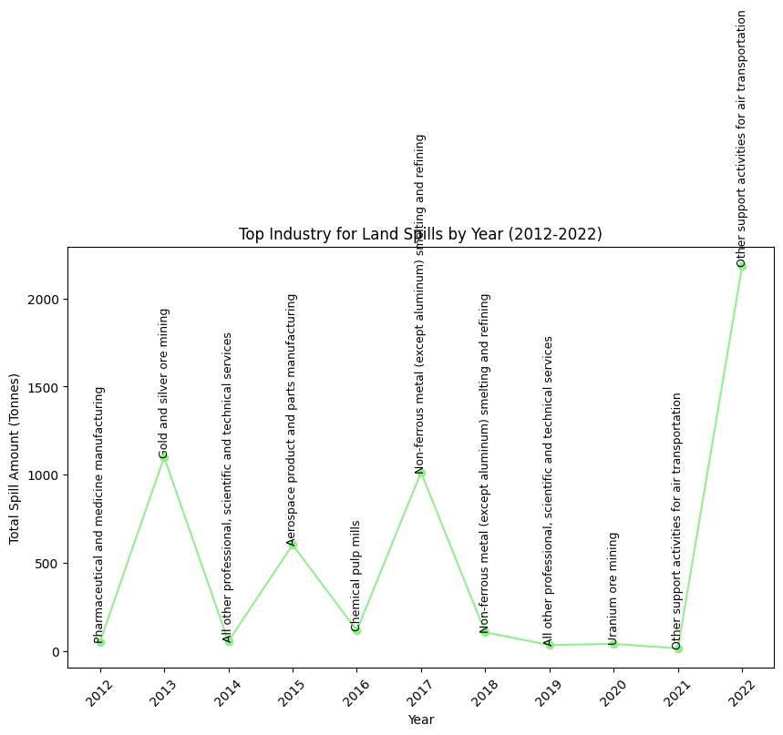
Top Industry for Land Spills by Year (2012-2022)
A curious fact about the 2017 spike in land spills in Canada’s non-ferrous metal (excluding aluminum) smelting and refining industry is tied to environmental challenges in this sector.
Notes:
Nav
we'll look at the top industries responsible for land spills in Canada from 2012 to 2022.
Main Content:
Let's start by examining the data. The graph shows the top industry for land spills each year over the past decade.
In 2017, we see a significant spike in land spills in the non-ferrous metal (excluding aluminum) smelting and refining industry. This spike is noteworthy because it highlights major environmental challenges in this sector.
One fascinating fact is that despite efforts to manage industrial waste, certain sectors, like non-ferrous metal refining, continue to face obstacles in reducing environmental impacts. This spike serves as a reminder of the complexities involved in balancing industrial activity with environmental responsibility.
In more recent years, we notice a shift, with 2022 showing a peak in land spills for support activities for air transportation. This data reflects how industrial focus changes over time, yet environmental challenges remain relevant across sectors.

Slide 11
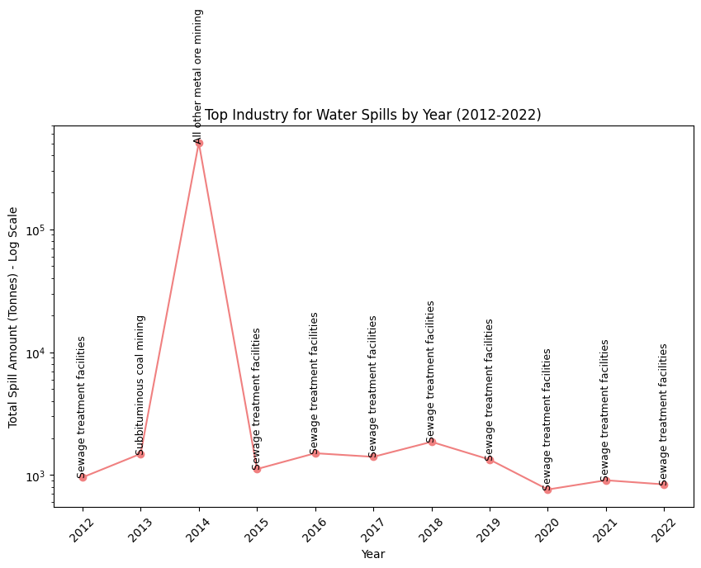
Top Industry for Water Spills by Year (2012- 2022)
Dominance of Sewage Treatment Facilities: Apart from the 2014 coal mining peak, sewage treatment facilities consistently lead water spills in all other years. This suggests that while these facilities play a critical role in managing wastewater, they also present a continual risk of water spills, possibly due to aging infrastructure, overflow incidents, or operational challenges.
Notes:
Dionathan Sewage treatment facilities dominate water spills across most years, except for a major spike from coal mining in 2014. This pattern reveals a hidden challenge: while sewage facilities manage critical wastewater tasks, they also pose ongoing spill risks, likely from aging infrastructure and operational issues. This highlights the need for robust maintenance to prevent these frequent spills."

Slide 12
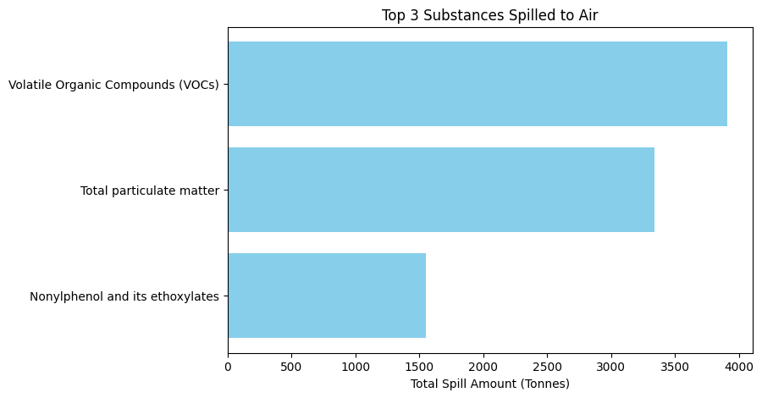
Top 3 Substances Spilled to Air
Notes:
Vinit

Slide 13
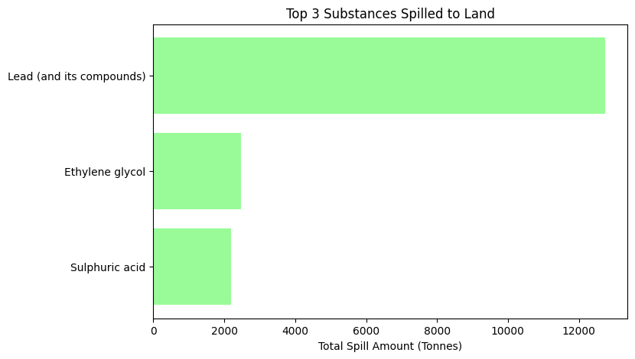
Top 3 Substances Spilled to Land
Notes:
Harsh

Slide 14
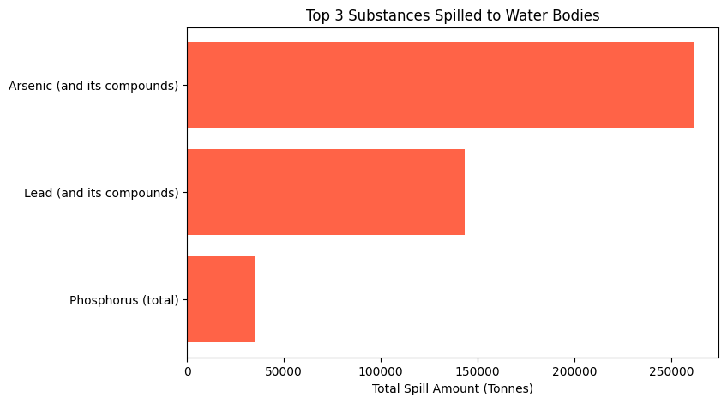
Top 3 Substances Spilled to Water Bodies
Notes:
Nav
This slide shows the top 3 substances spilled into water bodies.
Arsenic (and its compounds): This is the substance with the highest spill amount.
There are different types of arsenic compounds, including:
Inorganic, organic and ARSENIC gas.
Even just to let you know that Arsenic gas is very common and it is very Toxic for enviornment
Then we have lead and phosphorus.
These spills into our water bodies are a significant environmental concern. Understanding the quantities of these harmful substances helps us take action to protect our water and health.

Slide 15
Fixing Bad Housekeeping
We performed a fixing in Bad Housekeeping by:
Column Name Cleanup:
To standardize column headers, a function was defined to:
Remove extra spaces,
Convert all column names to lowercase,
Replace non-alphanumeric characters with underscores.
Handling Inconsistent Data Types: Ensures uniform data types across numeric fields for accurate calculations.
Categorizing and Encoding Categorical Features: Categorical data was encoded and missing values are labeled as "Unknown" to retain data integrity for modeling.
Notes:
Dionathan

Slide 16
Handling Outliers
We applied two outlier detection methods:
The IQR (Interquartile Range) Method and Isolation Forest. The IQR method identified outliers based on statistical thresholds, significantly reducing mean values and thus lowering the impact of extreme values on analysis.
In contrast, Isolation Forest detected anomalies through an algorithmic approach, slightly reducing entry counts, leading to a dataset that better represents typical spill values.
Who performed better?
To maintain the data’s overall structure and reduce only extreme anomalies, Isolation Forest is better because it’s more targeted and less disruptive to the dataset.
Notes:
Vinit

Slide 17
Handling NaN Values
We approach to handling NaN values aimed to retain as much data as possible without dropping rows, thereby preserving the dataset's structure and preventing data loss.
By labeling unknown categories, the dataset remains comprehensive and suitable for modeling.
The only data deleted, was the non-necessary releases for the group's problem
Notes:
Harsh

Slide 18
Classification - ML
Here’s a concise summary of the steps taken to create and evaluate the spill risk classification model, perfect for a slide:
Spill Risk Classification Model Development
Data Preparation
Aggregated dataset to include company, substance, industry, spill type, and yearly spill count.
Created target variable (spill_risk_category) by classifying companies into High, Medium, or Low Risk based on cumulative spill counts.
Data Preprocessing
Encoded categorical features (e.g., industry, spill type) and scaled numerical data (spill count).
Split data into training (up to 2019), validation (2020), and test (2021-2022) sets.
Baseline Model
Built a Logistic Regression model to predict spill risk levels.
Evaluated on validation set; identified need to improve High Risk recall.
Hyperparameter Tuning
Performed Grid Search to optimize regularization strength (C) and class weights.
Selected the best model based on weighted F1-score.
Final Evaluation
Tested tuned model on test data, achieving high accuracy for Low Risk but moderate recall for High Risk.
Industry Insights
Identified top 10 industries at highest and lowest predicted risk for each spill type (Air, Land, Water) using model results.
Notes:
Nav
At this point, let's discuss the steps we took to build our spill risk classification model.
Data Preparation:
We collected data on company names, substances, industries, spill types, and yearly spill counts.
We created a target variable, "spill_risk_category," to classify companies into High, Medium, or Low Risk based on cumulative spill counts.
Data Preprocessing:
We encoded categorical features like industry and spill type.
We scaled numerical data like spill counts.
We split the data into training (up to 2019), validation (2020), and test sets (2021-2022).
Baseline Model:
We built a Logistic Regression model to predict spill risk levels.
We evaluated the model on the validation set and noticed it needed better recall for High Risk.
Hyperparameter Tuning:
We used Grid Search to optimize regularization strength (C) and class weights.
We selected the best model based on the weighted F1-score.
Final Evaluation:
We tested the tuned model on test data. It showed high accuracy for Low Risk but moderate recall for High Risk.
Industry Insights:
We identified the top 10 industries at the highest and lowest predicted risk for each spill type (Air, Land, Water) using the model's results.

Slide 19
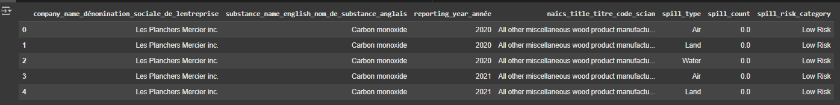
Classification - ML
Dataset
Columns:
Company Name (company_name_dénomination_sociale_de_lentreprise): Name of the reporting company.
Substance (substance_name_english_nom_de_substance_anglais): Type of substance involved in the spill (e.g., Carbon monoxide).
Year (reporting_year_année): Year of the report.
Industry (naics_title_titre_code_scian): Industry classification according to NAICS.
Spill Type (spill_type): Type of environmental medium impacted (Air, Land, or Water).
Spill Count (spill_count): Recorded quantity or count of spills.
Spill Risk Category (spill_risk_category): Assigned risk level (Low, Medium, High) based on cumulative spill counts.
Purpose:
Structured to facilitate classification modeling by summarizing company, substance, and spill characteristics over time, with a target for predicting spill risk levels.
Notes:
Dionathan

Slide 20
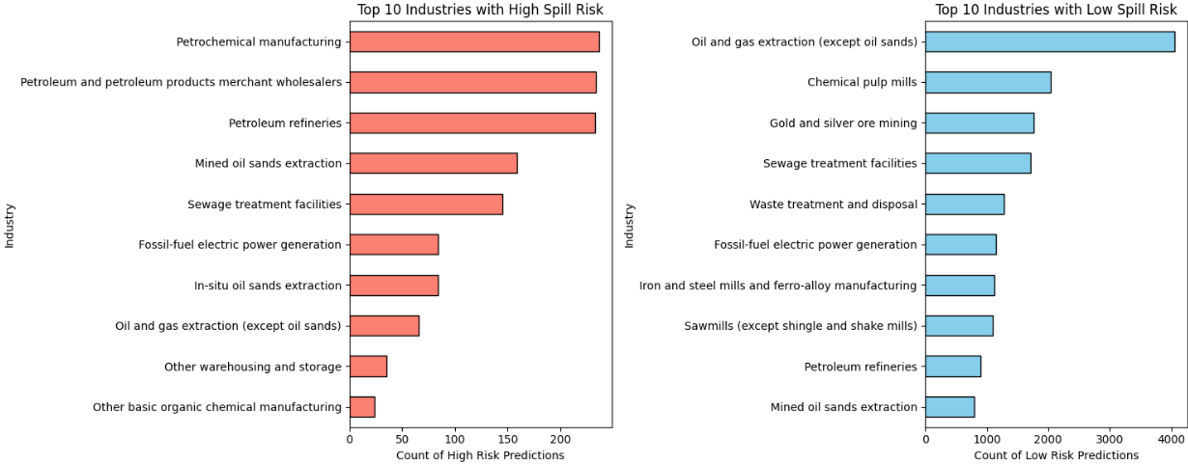
Classification – ML - Result
Notes:
Dionthan

Slide 21
Notes:
Vinit

